Slide 1





Source Control Systems
Git and GitHub
Teamwork
Course
SoftUni Team
Technical Trainers
Software University
http://softuni.bg

Slide 2

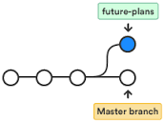

Table of Contents
Source Control Systems
Using Git
Installing and Using Git
Clone, Commit, Push
Resolving Conflicts
Using Branches
Using GitHub

Slide 3
Have a Question?
sli.do #softuni-teamwork

Slide 4


Version Control Systems
Managing Different Versions of the Same File / Document

Slide 5
Software Configuration Management (SCM)
Version Control System ≈ Source Control System
Tool for managing the changes during the development
A repository keeps the source code and other project assets
Keeps a full history of all changes during the time
Solves conflicts on concurrent changes
Popular source control systems
Git – distributed source control (hierarchical)
Subversion (SVN) – central repository (centralized)

Slide 6
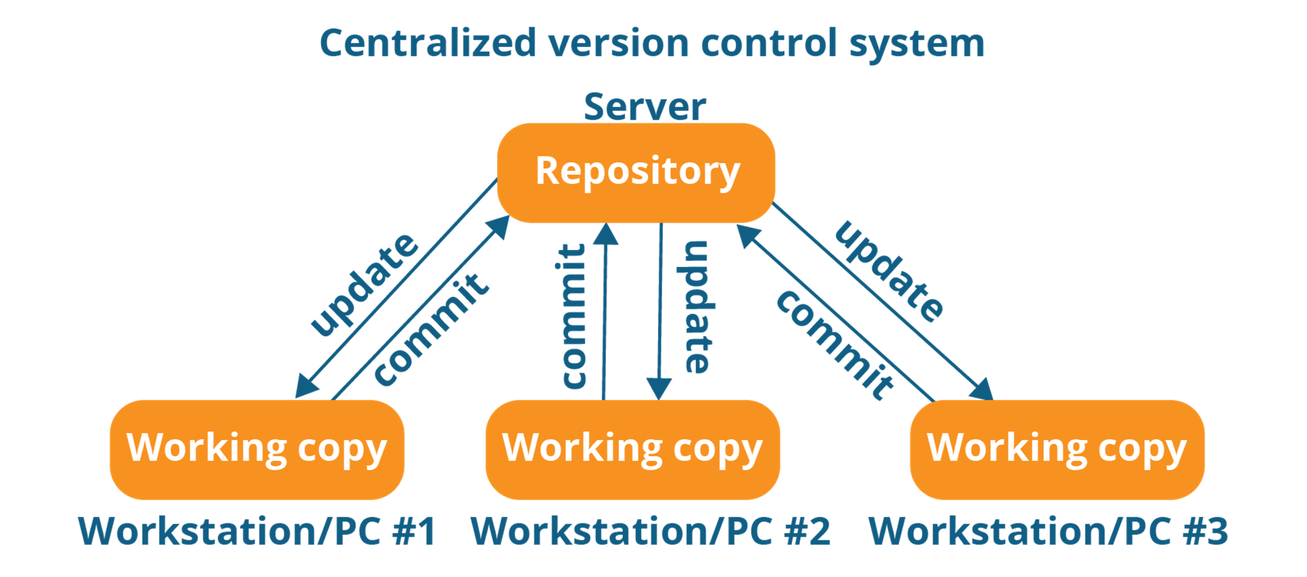
Centralized Version Control
Source: https://www.edureka.co/blog/what-is-git/

Slide 7
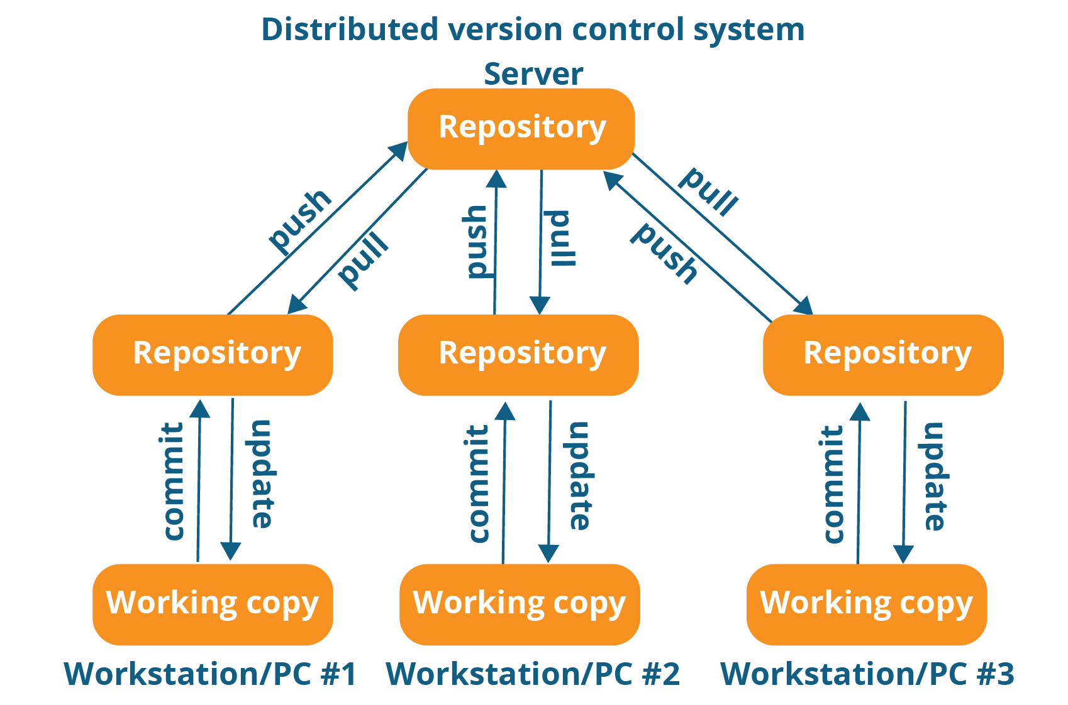
Distributed Version Control
Source: https://www.edureka.co/blog/what-is-git/

Slide 8
Git

Slide 9

What is Git?
Git == distributed source-control system
The most popular source control in the world
Free, open-source software
Works with local and remote repositories
Runs on Linux, Mac OS and Windows
https://atlassian.com/git/tutorials/install-git
GitHub == social network for developers
Free project hosting site with Git repository

Slide 10





Installing Git

Slide 11

Installing Git
On Windows
Installer: https://git-for-windows.github.io
Tutorial: https://atlassian.com/git/tutorials/install-git#windows
On Mac OS X
Installer: https://sourceforge.net/projects/git-osx-installer/files/
Tutorial: https://atlassian.com/git/tutorials/install-git#mac-os-x
Linux
Tutorial: https://www.atlassian.com/git/tutorials/install-git#linux
sudo apt-get install git

Slide 12
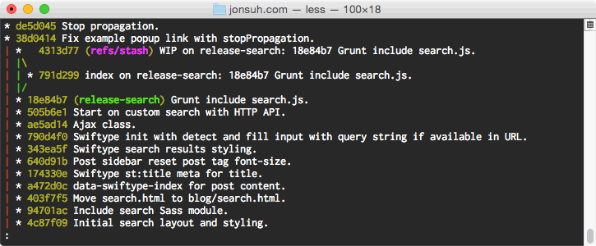
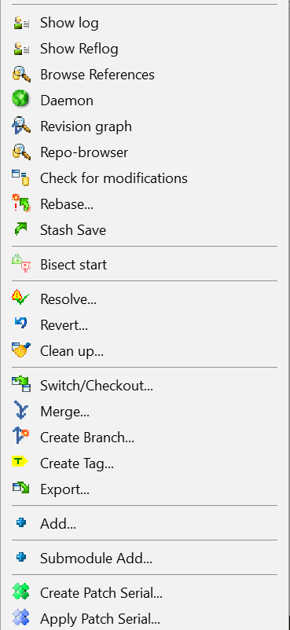
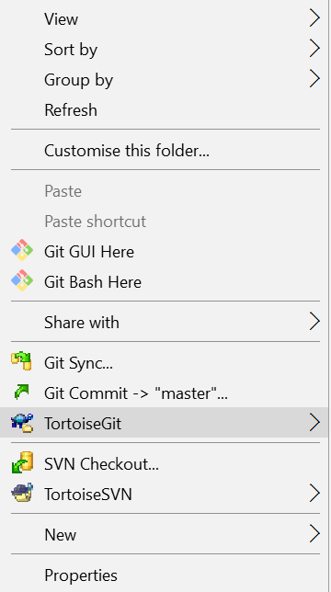
Using Git
Console-based client
git, GitBash
Windows GUI client – TortoiseGit
https://tortoisegit.org/download/
Visual Studio / Eclipse plug-ins
GitHub Desktop client
https://desktop.github.com

Slide 13
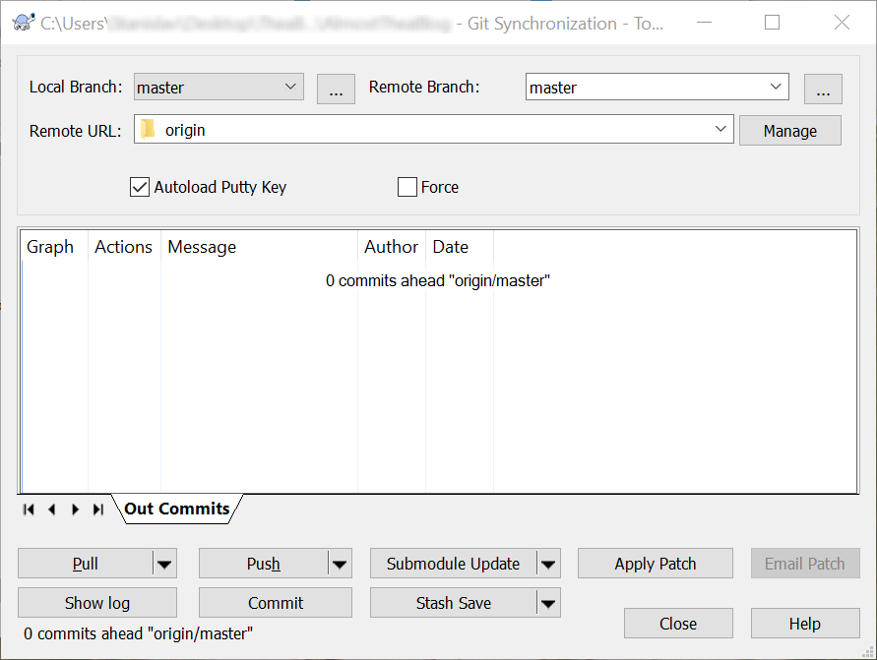

TortoiseGit
TortoiseGit is GUI tool for Git (for Windows)
https://tortoisegit.org
Simplifies the execution of Git command-line commands using UI

Slide 14
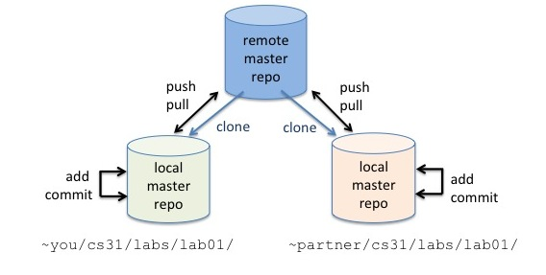
Git Workflow
Clone, Modify, Add, Commit, Push

Slide 15



How It Works?
git pull
edit files
git add
Modified
Staged
Committed

Slide 16
How It Works?
git push
git commit
Modified
Staged
Committed

Slide 17
Basic Git Commands
Clone an existing Git repository
Fetch and merge the latest changes from the remote repository
Add (prepare) files for commit
Commit added files to the local repository
git clone [remote url]
git pull
git add [filename] ("git add ." adds everything)
git commit –m "[your message here]"

Slide 18
Basic Git Commands (2)
Check the status of your local repository (see the local changes)
Push all committed changes to the remote repository
Create a new local repository (in the current directory)
Create a remote URL (assign a short name for remote Git URL)
git status
git push [remote name] [local name]
git init
git remote add [remote name] [remote url]

Slide 19
Using Git Commands: Example
mkdir work
cd work
git clone https://github.com/SoftUni/test.git
dir
cd test
dir
git status
(edit some file)
git status
git add .
git commit -m "changes"
git push

Slide 20
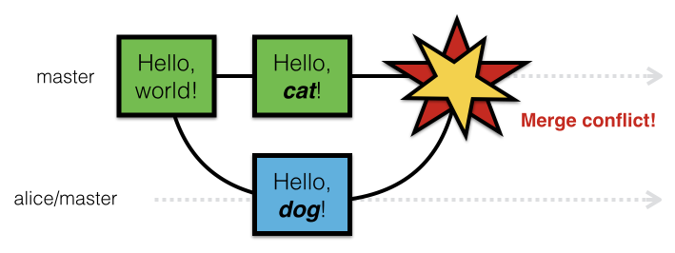
Resolving Conflicts in Git
Concurrent Changes to Certain Files

Slide 21




Git Conflict Scenario
3 developers work on a shared project with Git
All of them try to change and push the same file
A conflict will occur on push
peter
maria
george
change + commit
change + commit
change + commit
push
push
push
conflict
conflict

Slide 22
Resolving a Conflict: Example
Peter, Maria and George create a GitHub project
Initially they upload unfinished code for a "JS Town Editor"
3 source code files:
towns.html + towns.css + towns.js
Peter should implement "add new town" functionality
George should implement "shuffle towns" functionality
Maria should ass some CSS styling and improve the HTML UI

Slide 23
Resolving Conflicts in Git
Live Demo

Slide 24

Exercise: Introduce Yourself
Make an acquaintance with at least 2 colleagues around you
Ask typical questions like:
What is your name?
Where are you from?
What is your occupation?
What are your goals here at SoftUni?
Write the answers in a text file "colleagues.txt"

Slide 25

Acquaintance with Your Colleagues
Live Exercises in Class (Lab)

Slide 26
Exercise: Resolve Conflicts
Work in teams of 3 people (online students might work alone by cloning the project in 3 different folders)
The team leader does the following:
Fork the project "Towns": https://github.com/SoftUni/towns
Invite the other team members as collaborators: https://github.com/nakov/towns/settings/collaboration
Email invitation will be sent for each invited collaborator
Each team member clones the project from the team leader's GitHub repository

Slide 27
Exercise: Resolve Conflicts
Each team member implements different functionality
Member #1: Peter's functionality (add town)
Member #2: George's functionality (shuffle towns)
Member #3: Maria's functionality (improve styling and CSS)
The first push will be successful (no conflicts)
All next pushes will cause a conflict
The team members should merge correctly the concurrent changes (pull + merge + mark conflicts resolved + push again)

Slide 28
Resolve Conflicts in Git
Live Exercises in Class (Lab)

Slide 29
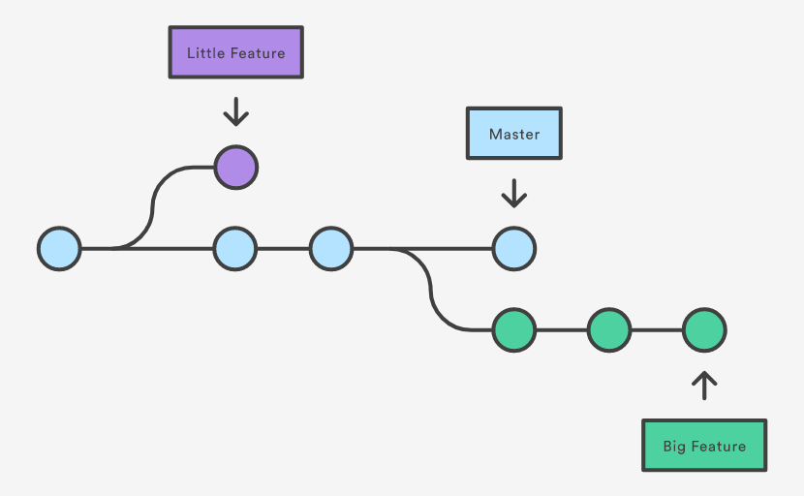
Using Branches in Git
Creating and Merging Branches

Slide 30
Git Branch
Branch - Independent line of development
New commits are recorded in the current branch
Forks the current project

Slide 31
Branching Workflow
Master
Merge Branch into Master
Feature

Slide 32
Git Branch (2)
List all branches
Create new branch
Switch to branch
Delete a branch
git branch
git branch <branch>
git checkout <branch>
git branch -d <branch>

Slide 33
Using Branches in Git
Follow the tutorial:
https://www.atlassian.com/git/tutorials/using-branches

Slide 34

GitHub
The Social Network for Developers

Slide 35
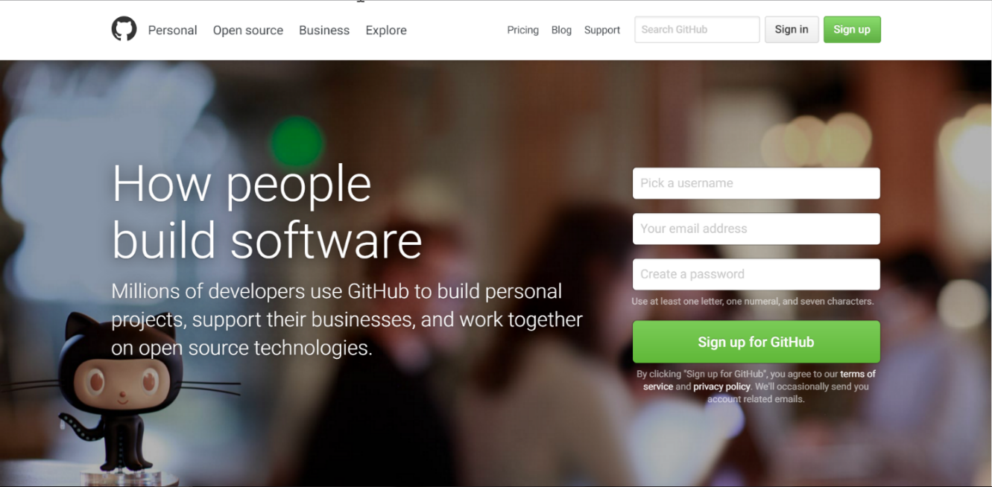
What is GitHub?
GitHub is the world's #1 source code hosting site
Free for open-source projects
Paid plans for private repositories
GitHub provides:
Git source code repository
Issue tracker (bug tracker)
Project board (Kanban style)
Wiki pages (documentation)

Slide 36

Summary
Use version control systems to work in a team
Keep the code in a central repository
Handle merge conflicts with ease
Important Git commands:
clone, add, commit, pull, push
GitHub == the world's most used software project hosting platform
Git repository, issue tracker, Kanban board, Wiki

Slide 37







Git and GitHub
https://softuni.bg/courses/practical-teamwork

Slide 38

License
This course (slides, examples, demos, videos, homework, etc.) is licensed under the "Creative Commons Attribution-NonCommercial-ShareAlike 4.0 International" license

Slide 39





Trainings @ Software University (SoftUni)
Software University – High-Quality Education, Profession and Job for Software Developers
softuni.bg
Software University Foundation
http://softuni.foundation/
Software University @ Facebook
facebook.com/SoftwareUniversity
Software University Forums
forum.softuni.bg

